Slide 1
AASHTO Freight Activities
Avital Barnea, Program Manager for Freight
Matt Hardy, Program Director for Planning and Policy

Slide 2
AASHTO at a Glance
Nonprofit, nonpartisan association
Represents highway and transportation departments in the 50 states, the District of Columbia, and Puerto Rico
Represents all transportation modes including air, highways, public transportation, active transportation, rail, and water
Primary goal to foster the development, operation, and maintenance of an integrated national transportation system

Slide 4
Freight at AASHTO
Special Committee on Freight
Chair: Vacant (Previously Roger Millar, Washington State)
Vice Chair: Caroline Mays, Texas DOT
AASHTO Staff Liaison: Avital Barnea
Committee on Planning, Freight Planning Task Force
Chair: Tom McQueen, Georgia DOT
AASHTO Staff Liaison: Matt Hardy
Working Group on Freight Operations
Co-Chairs: Matt Hedge, Pennsylvania DOT & Dave Huft, South Dakota DOT
AASHTO Staff Liaisons: Gummada Murthy & Pat Zelinski

Slide 5
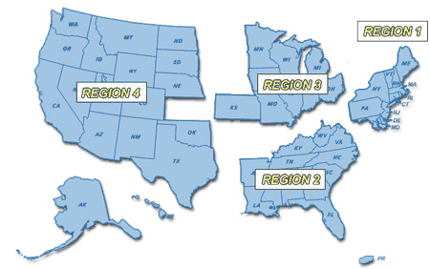
Special Committee on Freight
Regional Representatives
Modal Representatives
Trucking
Freight Rail
Waterborne Freight/Ports
Air Cargo
Active (Bike/Ped)

Slide 6
Special Committee on Freight
Goal 1: Develop and support legislation, regulation, and other policy matters related to the efficient, safe, and sustainable multimodal movement of goods.
Goal 2: Improve freight transportation planning practices through the enhancement of freight data and analytical methods and the dissemination of best practices.
Goal 3: Increase the understanding of emerging technologies and issues related to freight transportation and their implications for State DOTs.
Goal 4: Improve urban, rural, multi-state, cross-border, and international freight mobility.
Goal 5: Promote a freight transportation system that supports community and environmental goals.
Goal 6: Inform member departments of federal and state regulatory, policy, and program requirements and funding opportunities related to freight transportation.

Slide 7
Special Committee on Freight
Goal 2: Improve freight transportation planning practices through the enhancement of freight data and analytical methods and the dissemination of best practices.
Support research to improve understanding of new freight data sources and freight analytical tools, and to develop guidance for utilizing and integrating different freight datasets for freight planning, forecasting, modeling, and reporting (i.e., dashboards).
Advocate for and support research that identifies gaps and deficiencies with available national freight data and propose strategies to address these gaps and deficiencies.

Slide 8
Special Committee on Freight
Goal 3: Increase the understanding of emerging technologies and issues related to freight transportation and their implications for State DOTs.
Coordinate with TRB freight committees, to identify, define, and secure funding for research studies related to emerging freight technologies and issues.
Share information on relevant existing TRB research products and other resources.

Slide 9
Special Committee on Freight
Goal 4: Improve urban, rural, multi-state, cross-border, and international freight mobility.
Support research, information sharing, and advocacy for improving planning and programming for truck parking, in coordination with FHWA’s National Coalition for Truck Parking.
Coordinate with TRB freight committees to identify, define, and secure funding for research studies related to truck parking.

Slide 10
Special Committee on Freight
Goal 5: Promote a freight transportation system that supports community and environmental goals.
Support research on strategies that improve environmental sustainability while ensuring system efficiency.
Support research on strategies that advance community livability efforts while ensuring system efficiency.

Slide 11
Special Committee on Freight
Other Activities
Surface Transportation Reauthorization
Year One Priority Tasks
MPO Outreach
Webinar Series Development
Truck Parking
Economic Impacts of Freight System Improvements
Submit/Support Research Needs Statements for NCHRP Funding

