Slide 1
TRB 91st Annual Meeting
Meredith Davis
Freight Planner
NOACA
January 23, 2012

Slide 2
Presentation overview
Introduction to NOACA and NE Ohio
Regional Freight Flows
Regional Freight Infrastructure
Current Freight Planning Efforts and future goals

Slide 3
Introduction to the Region

Slide 4
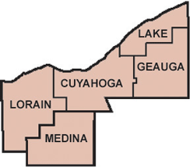
Who is NOACA?
Five county region of Northeast Ohio
Population of 2,077,240
854,893 households
1,878,788 registered
vehicles
Total Daily VMT: 48,588,288
Allocates $48 million annually for projects
Notes:
NOACA serves the five county region of northeast Ohio and is the largest metro area in the state with a population of over 2 million
We have almost 900,000 households and 2 million registered vehicles
Our total daily vmt is just about 50 million
We have a governing board of 44 members and allocates approximately 48 million dollars annually in projects

Slide 5
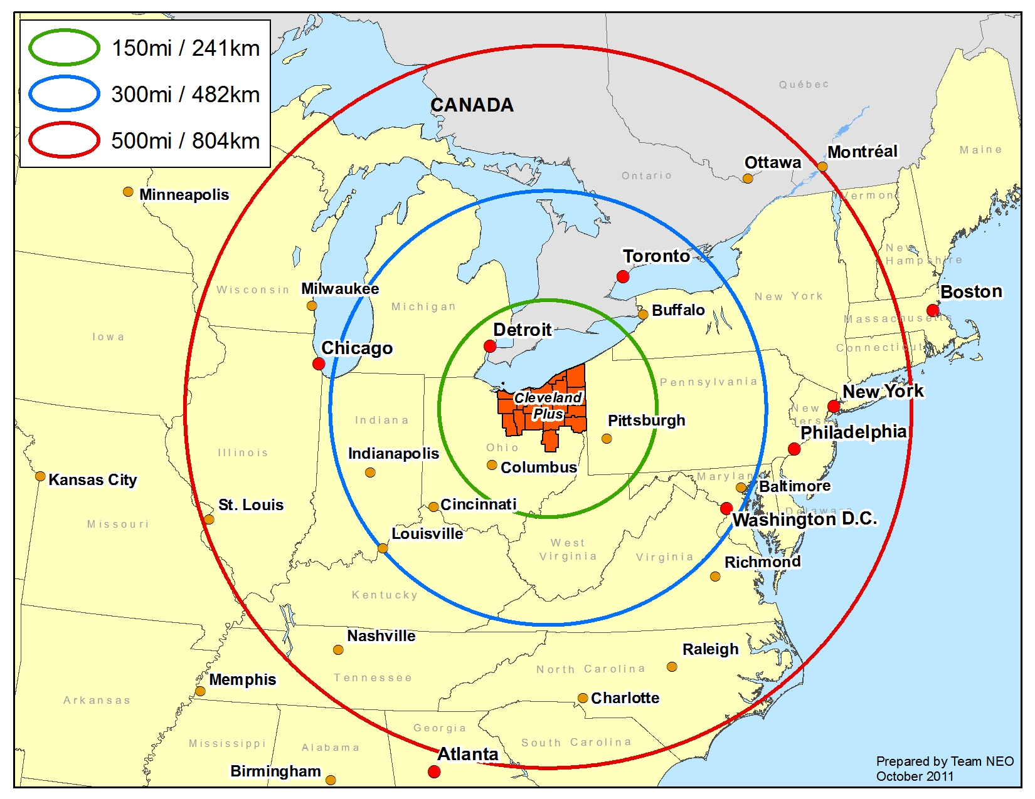
Northeast Ohio Region
Notes:
The region of northeast Ohio is more than just NOACA’s 5 county territory, we are actually three functioning labor and economic markets that are interwoven.
We have low-cost access to the heart of the US economy
In 2007 Expansion Management Magazine published its list of metro areas with the strongest infrastructure. 99% being the highest, the Cleveland Metro area received a five star rating and scored a 98%. Only 5 other MSA’s scored higher.
We are within 50% of all US manufacturing facilities, corporate headquarters, and households

Slide 6
Regional Freight Flows
Notes:
A brief look at our regional freight flows

Slide 7
FAF3 Regional Profile 2009
Notes:
Looking at and overview of freight flows from the FAF3, the northeast Ohio MSA imports just over 69 million k tons worth almost 77 million dollars.
Our region exports just over 41 million tons worth almost 72 million dollars
It is most important to note that though we import more than we export, we export proportionately more value per ton than we import.

Slide 8
Inbound and Outbound Commodities (2009)
Inbound
Value – base metals, plastic and rubber, coal and scrap metal
Weight – coal, metallic oars, gravel and base metals
Outbound
Value – base metals, plastics and rubber, and chemical products
Weight - basic chemicals, base metals, nonmetallic minerals
Notes:
Looking at what we import and export – and what do these commodities mean in terms of our economy and impacts on freight?
We are bringing in raw materials and adding value by creating and exporting manufactured items.
From parts for motor vehicles and aircrafts, fabricated metals and medical devices to flexible liquid crystal displays
Companies like Goodyear, Eaton, Parker Hannifin, Sherwin Williams, Timken, Lubrizol, Diebold, PolyOne, Smuckers, and Rolls-Royce (fuel cells division) all call northeast Ohio home

Slide 9
Northeast Ohio Infrastructure
Current state and conditions of northeast Ohio’s freight infrastructure
Notes:
So what is the current state of northeast Ohio’s freight infrastructure

Slide 10
Northeast Ohio’s Freight and Logistics Infrastructure
Columbus and Toledo
Columbus – Heartland corridor, Rickenbacker and the I-70 Corridor
Toledo – National Gateway project, Toledo Port, Toledo express airport?
Northeast Ohio?
Less rail, more trucks
Underutilized port, airport and pipeline infrastructure
Notes:
To better understand the freight in Northeast Ohio we need to look at freight activities in other parts of Ohio, specifically Columbus and Toledo.
The Rickenbacker inland port is a global multi-modal hub with a cargo-dedicated international airport, logistics park, and intermodal terminal servicing Norfolk southern and CSX
Just south of Toledo, Norfolk Southern has invested $175 million into a new, state of art, intermodal terminal expected to handle almost 2 million containers a year.
The port of Toledo continues to proactively peruse project cargo and Toledo’s airport historically has been a cargo hub, lifting the most cargo in the state.
This past summer, however, it was announced that the airports main cargo hub will be shutting down. The company sited the recession and spiking fuel prices and said that more of their customers are using trucks and trains rather than air freight.
What does all of this mean for northeast Ohio? Looking forward, it means less through rail traffic, more trucks and a greater impact on our road infrastructure.
We also have a lot of opportunities. While northeast Ohio used to known for steel and we do still make things, but what we make is changing.
We are a leader in advanced manufacturing, rubber and polymers, high-precision surgical instruments and high-quality pharmaceutical products.

Slide 11
Ports
Port of Cleveland
Average of 13.1 million tons per year
44 acre bulk terminal facility
Port of Lorain
Approximately 849 thousand tons (‘10)
Fairport harbor
Just over 1 million tons(‘09)
Notes:
Northeast Ohio is well positioned to move raw materials and finished goods via the waterways.
The port of Cleveland averages 13 million tons of cargo per year and has the best heavy lift capacity on the Great Lakes
with 9 births, 6,500 linear feet of dock space, and maintains a full seaway depth (27 feet)
the port also has a 44 acre bulk terminal facility
The port of Cleveland experienced a 60 percent jump in project cargo volume in 2011, largely as a result of heavy machinery, and the ports first- time handling of a wind turbine
The port of Lorain, to the west of Cleveland and Fairport harbor to the east, both move approximately 1 million tons of cargo per year
Both Cleveland and Lorain Ports have significant holding space and can easily accommodate intermodal movements.
Issues facing our ports are constant dredging and maintenance of sea level depths – and what to do with the dredge materials, ballast water management, and the lack of jurisdictional coordination within the region.

Slide 12
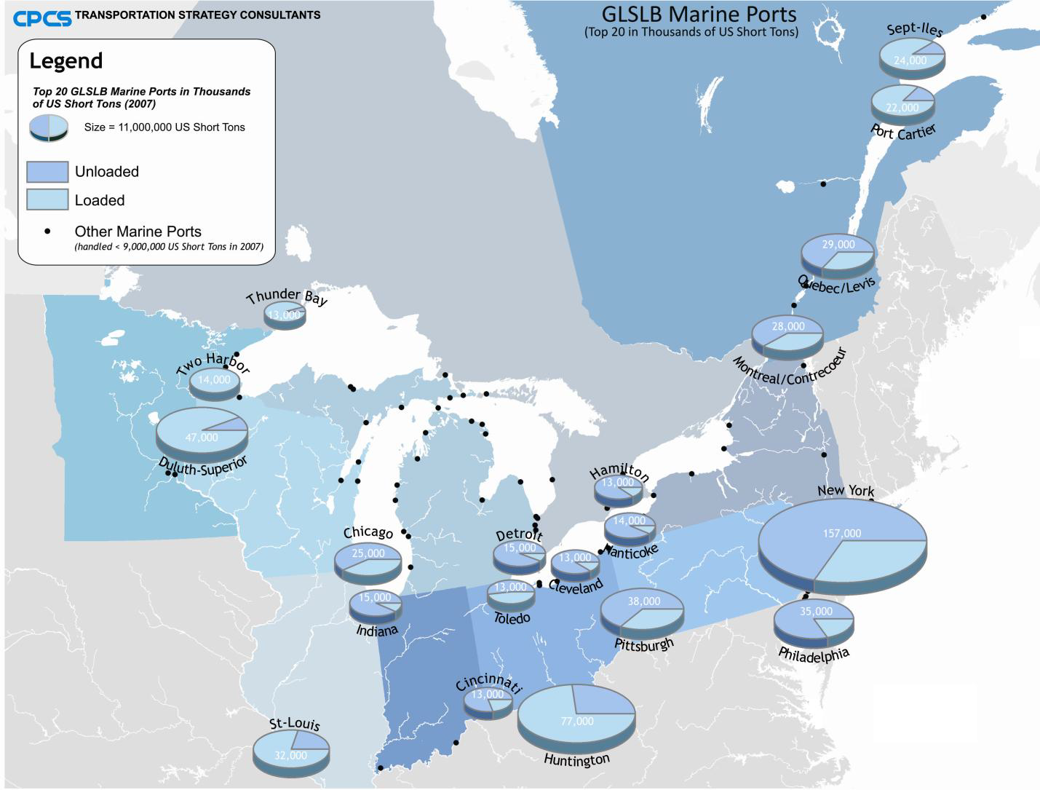
Source: NCFRP 35: Multimodal Freight Transportation within the Great Lakes -St. Lawrence Seaway
Notes:
This slide shows to top 20 ports in the great lakes region
The Great Lakes - St. Lawrence Seaway is a multimodal freight transportation system that plays an important role in connecting the economy of US and Canada.
It has 15 large international ports, 50 regional ports, 16 locks, and a large network of inland waterways
An estimated 200 million tons of cargo moves annually by water through the great lakes and St Lawrence Seaway
90 percent of its cargo is bulk, and industries rely on water transportation to move high volumes of iron ore, coal, petroleum, chemicals, cement and grain
With very little container traffic moving on the great lakes, the question is whether or not this waterway is being used to its highest potential. With increased traffic on rail and road networks, water can offer a capacity to help move container traffic. Though obviously there are some limitations and hurdles that will need to be addressed first.

Slide 13
Cleveland Hopkins Airport
Access to CSX rail to N-S and E-W highways
376 million pounds of cargo (landed weight)
Ranked 64th in air cargo, 3rd in Ohio
Toledo ranks 1st – 940.8 million pounds
Columbus/Rickenbacker 2nd – 730.5 million pounds
Air cargo demand is flat
Rising fuel costs?
Notes:
Cleveland is well connected to move goods to and from the airport, with easy access to interstates, the Port, and railroad operations
CLE had 376 million pounds of cargo in 2008 and is serviced mainly by FedEx but, UPS, USPS, DHL, and World Wide Freight Services all have operations at CLE
They between 12 and 17 daily cargo flights, with Fed Ex accounting for nearly three quarters of total cargo operations
Cargo declined by 7.3% in 2008 and is projected to remain flat or decline further in the future
CLE ranked 64th in the country and 3rd in Ohio with Toledo and Columbus lifting significantly higher amounts of cargo.
Expansion of cargo facilities at CLE could bolster demand in the future, and the air port is currently undergoing an update to their master plan, which includes expansion of their cargo facilites
One of the major caveats to expanding air cargo facilities is rising fuel prices. Will demand continue to even remain flat, or will a stronger demand offset rising costs? It seems too early to tell.

Slide 14
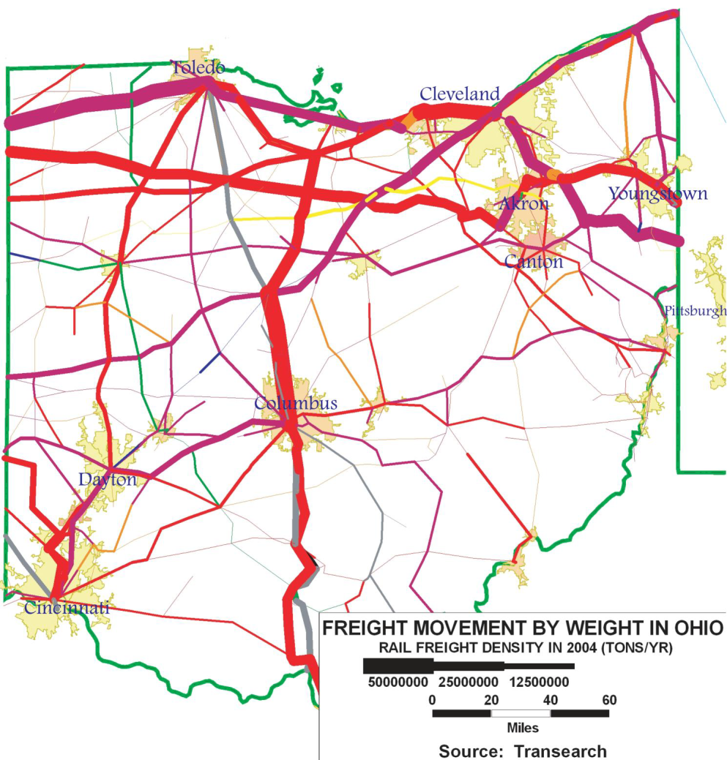
Rail
Redistribution hub - heavily utilized route between Chicago and east coast ports
“Waterlevel route”
2 Class I carriers
2 intermodal
terminals
10 Short line railroads
Notes:
Northeast Ohio lies along the heavily utilized rail rout between Chicago and the east coast. It is here that cars are redirected from Chicago to different major cities along the eastern seaboard.
The CSX route between Cleveland and New York is known as the waterlevel route – it follows along the lake, the erie canal and hudson river. This is significant because it has no bridges and allows for double stack trains at high speeds (60mph)
To serve our regional market we have two class I carriers and two intermodal terminals
we are is also served by excellent regional railroads
Both CSX and Norfolk Southern are making large investments in Ohio, just no in northeast Ohio. The concern is that the new terminals will complete for business with the existing, older terminals in northeast Ohio possibly resulting in reduced service levels for our manufactures.

Slide 15
Trucks and Road Infrastructure
I-90 east-west corridor
16 long Distance Trucking Companies
2 dedicated LTL carriers
Little congestion and excellent access
Shift to I-70 just 150 miles south
Privatization the Ohio turnpike
Inner belt bridge
Notes:
I-90 is most direct route from Boston to Seattle and runs directly through northeast Ohio
We have a strong presence of logistics companies with 16 long haul and 2 dedicated LTL carriers
Feed back from a recent freight survey was overwhelmingly positive when asked about congestion and access on the regions road infrastructure.
It is important to note that truck traffic is expected to grow over the next 20 years, planning now for this increase is crucial to the economic growth of our region
Recently there has been a shift at the state level to focus on the I-70 corridor, just 150 miles south of Cleveland, as the future truck corridor.
Freight traffic may been moving to Columbus, but this is because they are a distribution center, not necessarily because they are major manufacturing center. We still have significant freight movements and needs.
There is much debate in Ohio regarding the privatization of the Ohio turnpike – more to come…
Other important infrastructure projects making headlines is the inner belt bridge project – more to come…

Slide 16
Pipelines
Direct access to Gulf Coast and Canada
5 petroleum refineries in Ohio
Low cost, secure supply of petroleum
Yellow Roadway, FedEx and NS all located next to pipelines in NEO
Marcellus Shale
Notes:
Northeast Ohio has an extremely robust pipeline network, as we are located at the end of several major pipelines
Gulf Coast and Canadian Refiners can access NEO using four main pipelines that connect directly to our region
Ohio is also home to 5 refineries which equates to a low cost and secure supply of petroleum.
Local companies take advantage of this and locate around the pipelines to have direct access
The Marcellus and Utica Shale is perhaps the biggest unknown in the equation. New pipelines will need to built to transport millions of cubic feet of natural gas per day
New manufacturing plants are already either reopening or building new plants around the shale deposits.
Shell Oil announced plans to build a new chemical plant, brining thousands of new jobs and millions of tax dollars to either Pennsylvania, West Virginia or Ohio. The plant would make ethlyene, used to produce chemicals that go into everything from plastics to tires to antifreeze.
the specific measure is unknown, but the Marcellus shale had the potential of making a huge impact on the entire region’s economy and infrastructure.
Note: Ultimately, it is physically received in NEO and if an actual receiver has not been located the products must be significantly discounted to find a customer. As a result, according to Bob Maloney, owner of Bulk Trading, Northeast Ohio is a place where gasoline/diesel is “dumped” for several months out of each year.

Slide 17
Where do we go from here?
Northeast Ohio potential and freight planning efforts
Notes:
Where do we go from here and how to plan for it?

Slide 18
Northeast Ohio Potential
Location and Access
Low congestion
Airport with rail and highway access
Lake Erie and deep water ports
Passenger ferry service
Cargo container operations – feeder service to Montreal
Project and heavy cargo
Notes:
As I mentioned Northeast Ohio is strategically located within 50% of all US and Canadian manufacturing facilities - and this means lower transportation costs
Our lack on congestion on roads is currently an asset for shippers within our region, though truck freight is expected to grow in the future and we need to plan accordingly.
We also have an airport and port with underutilized and access capacity.
The port of Cleveland and Port Stanley, Ontario have begun gauging interest for a cross-lake ferry service. As a pilot project the service would focus on tourism, recreation and other passenger demands with only limited truck traffic, though a cross-lake service focused on trucking is not off the table.
Cleveland is also looking to bring “containerships” into the Great Lakes. Even with today’s weak economy, there are delays and congestion at our Eastern and Western ports that could be alleviated by containerized shipping on the great lakes.
As a manufacturing center, NEO makes and ships large and heavy products. They currently move by rail and truck that require oversize/overweight permits. Water is the ideal way of handling such products since 1) ships are constructed to handle such cargos and in a cost effective manner, and 2) overweight trucks crush our roads. The Port of Cleveland could develop a niche as a hub for such cargos

Slide 19
Northeast Ohio Potential – strong industrial base
Advanced manufacturing
Chemicals and polymers – polymer valley
Access to Rotterdam and Saudi Arabia
Medical and devices industry
Refrigerated industry
Connecting pipelines with transportation
Notes:
While Northeast Ohio is no longer a steal town, we do still make things. The regions economy has transitioned into Advanced manufacturing. Our expertise in metalworking, polymers and electronics, combined with a highly skilled workforce create a unique industrial resource that demands an efficient and cost effective freight network.
NEO is a part of the “polymer valley” and has an extensive chemicals industry. The major European chemical port is Rotterdam and the major resin source is Saudi Arabia. The shortest distance to these locations is the all-water route from NEO.
NEO has a renowned medical facilities that are fueling an explosion in the medical devices industry. This hub will continue to expand NEOs footprint in the medical field and strengthen both the field and the region.
Refrigerated containers coming to Cleveland from abroad are trucked from the east coast ports and from Nova Scotia (NS and CSX do not move them by rail since vibrations cause refrigeration failures). However, refrigerated containers can be securely delivered by water to the Port of Cleveland, making NEO a “cold port” from which refrigerated cargos could be distributed throughout the state by truck.
Due to our unique access to the world’s petroleum markets, prices for petroleum products are often lower in NEO than elsewhere. Between petroleum and the Marcellus shale natural gas deposits, NEO is a great home for transportation and manufacturing companies that consume large quantities of fuel. Connecting them to pipelines will make them more profitable and allow them to expand operations.

Slide 20
Current Freight Planning Efforts – 1st year
Hired a freight planner and point-of-contact
Included freight into long-range plan, TIP and technical studies
Continued engagement of private sector stakeholders
Made the Port of Cleveland a NOACA Board Member
Conducted a freight survey
Notes:
NOACA hired their first ever dedicated freight planner, creating a consistent point of contact and champion within the MPO
Freight has always had a section in our long range plan and work plan, but not until now has it been addressed on a consistent basis. For the first time or project planning review process includes a freight related aspect
We have also worked hard this past year to become more involved with the major stakeholders in our region. Little things like talking to the Port about the importance to working together and making them a member of our Board have gone a long way in creating those relationships that are required to advancement freight in our region.
We also conducted our first ever freight survey. The online survey was the beginning step in our effort to identify key freight needs and deficiencies. It also acted as our first introduction into the freight community and gave us a chance to let them know who we are and what we do.

Slide 21
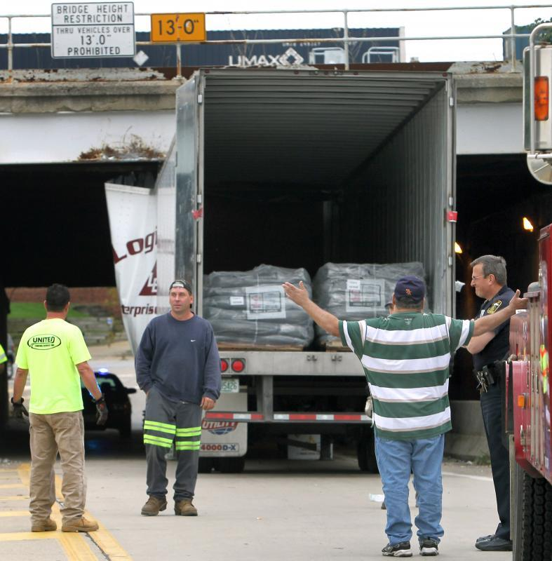
Current Freight Planning Efforts
Developing a regional freight profile -
FAF 3
Building a GIS database of freight infrastructure, assets and deficiencies
Freight Hot Spots
Expanding NHS Intermodal
Connector Analysis
examine of the connection
between facilities
Notes:
The purpose of the Freight profile is to help identify the freight system and how goods are moved through that system.
We are starting by looking at how and what commodities are flowing into, out of, and through our region using FAF3 data, but this is just a stepping point in our effort to create a complete profile.
We are also currently working on creating a complete GIS data base of freight related infrastructure including assets and deficiencies. We have never in the past compiled all freight related files into one GIS project. We have stared by updating our truck ADT maps and identifying low bridges, specifically those that are causing problems for trucks.
The bridge in this picture was run into three times over the course of a few months this past fall.
And, as a part of our NHS intermodal connector analysis we are beginning to look at not just connection to each facility, but the connections between facilities.

Slide 22
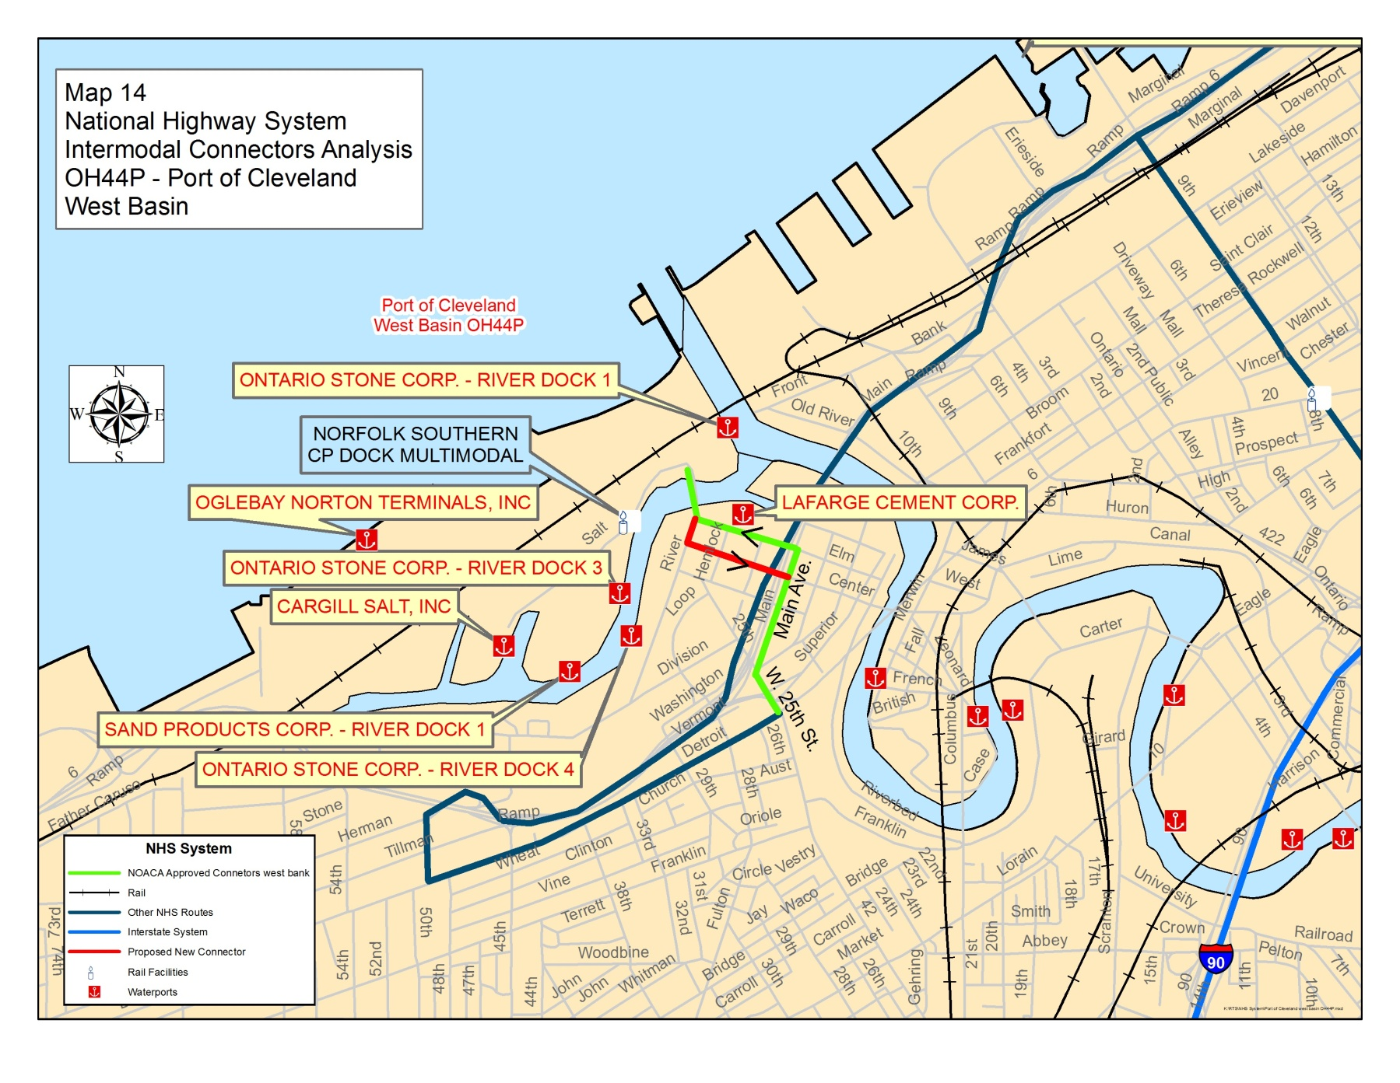
Map of an intermodal connector

Slide 23
Future Freight Planning Goals
Create freight performance measures
Construct an economic profile of freight in our region
Identify freight corridors
Form a Freight Committee
Identify and validate potential freight-related projects
Build ground work for eventual freight study
Notes:
Thanks to the push of organizations like the TRB we will be pursuing the creation of freight performance measures or indicators. While this will be a long term project we do believe it is important to begin to gauge reliability, safety, and infrastructure performance.
Our economy depends of the transportation of freight and it is important that we talk about freight as driver of economic development in our region.
We will also begin to identify corridor investment needs in order to sustain jobs and economic development for existing and future industrial and employment centers
NOACA has been gauging interest in establishing a Freight Committee and there seems to be sufficient initial support from the freight community. A credible freight committee with a defined vision will give the leverage needed to identify, validate and support freight related projects.
One example of when a freight committee would be useful is with a Port of Cleveland project. The have a large bulk terminal and facility with excellent rail access, but do not have truck access to site. The port is just now starting to work with us, but still cannot get the city and council members to the table.
All of this really feeds into our final long term goals, which is to conduct a full blow freight study of our region. We may be behind the curve but please check back with us in a few years and see how we have advanced our freight planning efforts.
I’d like to thank Ted Daulburg for inviting me to speak with you today and also to NEOTEC and Doctor Brad Hull for his continued assistance and support of bettering freight transportation in our region.

Slide 24
Mark Your Calendars!
NHI’s Advanced Freight Planning Course
April 24th – 25th
Hosted by NOACA

Slide 25
Questions
Meredith Davis
email: mdavis@mpo.noaca.org
phone: 216-241-2414 ext.350

