Slide 1
Chicago Truck Route Planning Study
Collaborative approaches to designating an urban freight system
5th International Urban Freight Conference 2013
Elaine Croft McKenzie, PhD
October 8, 2013

Slide 2
Overview
Chicago’s Truck Route Planning Study
Technical, policy, and legislative issues surrounding truck route system
Identify revisions to improve system effectiveness.
CS - Researcher
CDOT - Practitioner
Will assemble data AND gather information
Technical expert
Understands industry perspective
Works with others to designate and administer truck route system
Day to day activities (permits, routing, enforcement, etc.)
Conduct analysis
Public sector coordination
Other Partners & Stakeholders

Slide 3
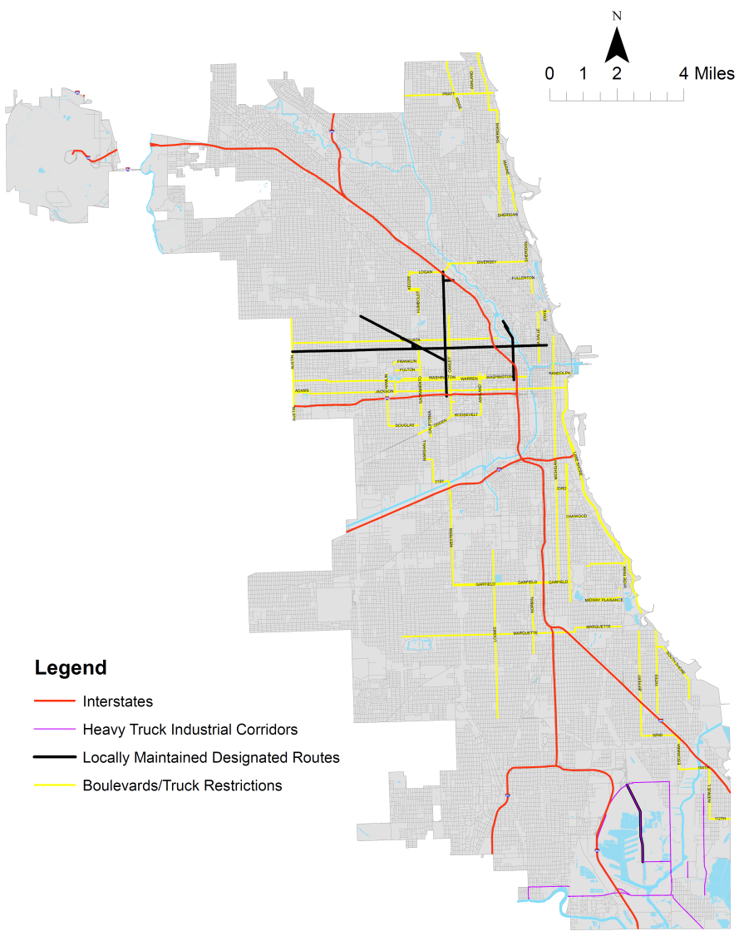
The Chicago Truck Route System
Previous attempts to designate a system have been unsuccessful
Goals of the project require a collaborative approach
Allow truckers to find safe, effective routing from origin to destination
Enable enforcement of truck size, weight and route laws
Highlight opportunities for cross-jurisdictional coordination and economic development
Source: City of Chicago
IDOT, gettingaroundillinois.com
Cambridge Systematics
Notes:
-Previous attempts have not resulted in a comprehensive system
Truck route system goals – came up with in conjunction with the city
Goals only possible with collaboration – need to bring in other staekholders
Safe, effective routing NOT JUST WITHIN THE CITY
Enforcement – state, local
Coordination with other jurisdictions are a ‘win win’ – you don’t want a system that routes trucks through the city and strands them because they can’t get through other areas

Slide 4
Chicago Truck Route System Stakeholders
Chicago Truck Routes
Chicago Department of Transportation
Emergency Management
Streets and Sanitation
System Users (Industry)
Cook County, CMAP, and Surrounding Municipalities
Illinois Department of Transportation
planning, permitting, construction
emergency vehicle access, hazmat transport
Snowplows, sanitation
truckload, less-than-truckload, intermodal, intra-city industry
planning, construction
planning, permitting, construction
System Users (Other)
Automobiles, pedestrians, bicyclists
Notes:
Stakeholders did not speak to each other
We added connections through collaboration

Slide 5
Chicago Truck Route System Stakeholders
Chicago Truck Routes
Chicago Department of Transportation
Emergency Management
Streets and Sanitation
System Users (Industry)
Cook County, CMAP, and Surrounding Municipalities
Illinois Department of Transportation
planning, permitting, construction
emergency vehicle access, hazmat transport
Snowplows, sanitation
truckload, less-than-truckload, intermodal, intra-city industry
planning, construction
planning, permitting, construction
System Users (Other)
Automobiles, pedestrians, bicyclists
CS – CDOT Collaboration
Notes:
Stakeholders did not speak to each other
We added connections through collaboration

Slide 6
Chicago Truck Route System Stakeholders
Chicago Truck Routes
Chicago Department of Transportation
Emergency Management
Streets and Sanitation
System Users (Industry)
Cook County, CMAP, and Surrounding Municipalities
Illinois Department of Transportation
planning, permitting, construction
emergency vehicle access, hazmat transport
Snowplows, sanitation
truckload, less-than-truckload, intermodal, intra-city industry
planning, construction
planning, permitting, construction
System Users (Other)
Automobiles, pedestrians, bicyclists
CS – CDOT Collaboration
Notes:
Stakeholders did not speak to each other
We added connections through collaboration

Slide 7
Collaboration Approach
Collect and analyze data from many sources
Current system, proposed changes, viaduct and obstacle clearances, truck restrictions, etc.
Output into GIS maps
Policy research and public sector coordination
Gather and analyze policies, municipal codes, previous studies
Need an approach that works for all levels, from IDOT to Chicago
Stakeholder engagement and outreach –
Within the Chicago DOT (interviews, surveys, PAC)
Other public sector agencies (PAC, surveys)
Industry (PAC, surveys, focused roundtables)

Slide 8
Gathering Supporting Data
Chicago Metropolitan Agency for Planning (CMAP) & CDOT
Truck AADT
Adjacent land use (e.g. industrial zones and corridors)
Other regional truck routes
City of Chicago
Vertical clearance restrictions
Illinois DOT
Bridge weight limits
Others
Intermodal connectors
Interstate and State Route interchanges
Data from multiple stakeholders is helping inform the future truck route system.
Notes:
Who gave what to who?

Slide 9
Successful Collaboration Example - ITA
Collaboration with Illinois Trucking Association (ITA)
ITA not only represented its members, but also gave us direct access to work with company representatives
Roundtable review of proposed system with executives, managers, and daily drivers
Allowed us to get information that did not exist as “data”
Industry Roundtable Focus Areas
Route-level designation
Intersections, Viaducts, Signs
System Overview, Policy Issues

Slide 10
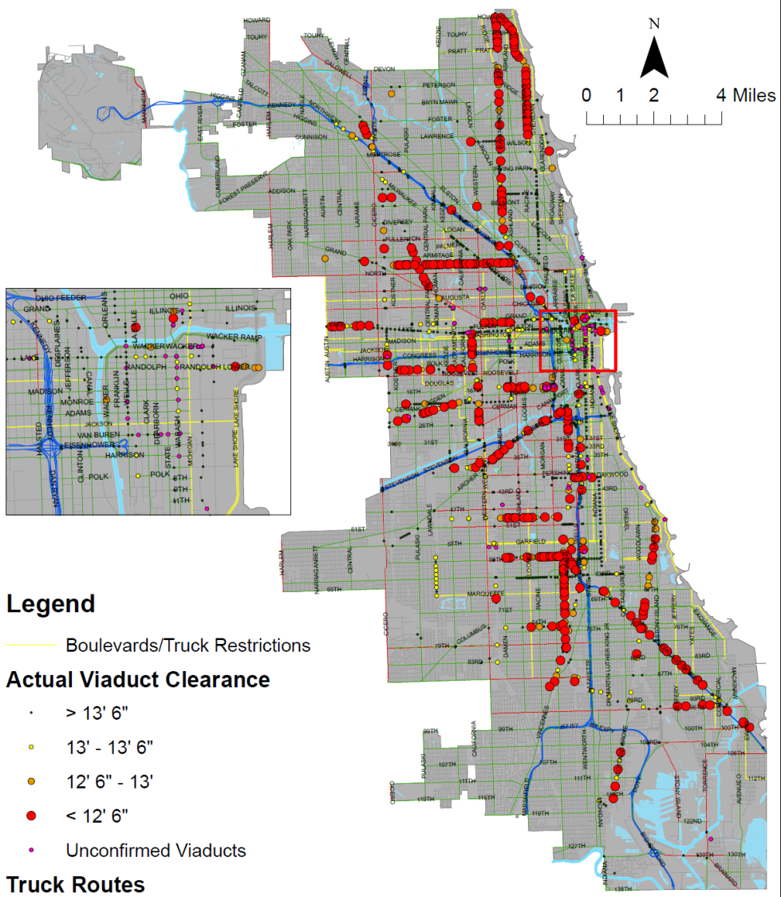
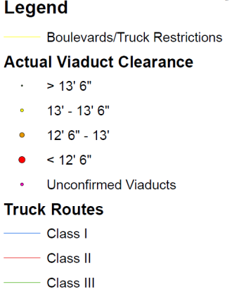
Vertical Clearance Restrictions
Source: City of Chicago
Cambridge Systematics

Slide 11
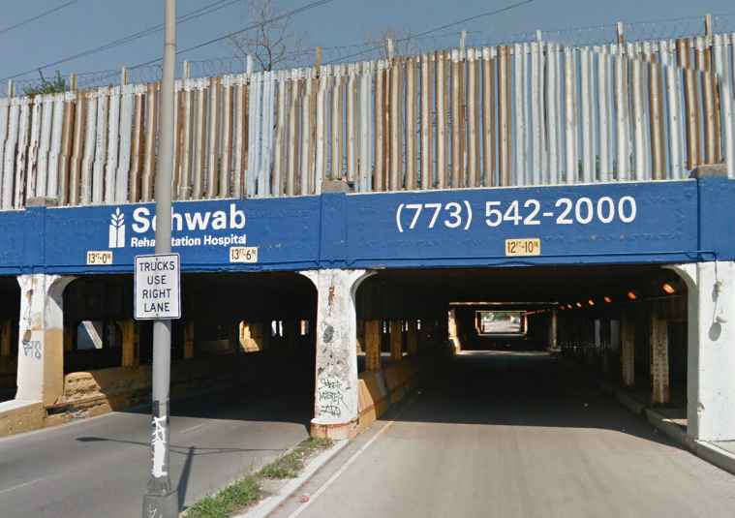
Vertical Clearance Restrictions
Source: City of Chicago
Cambridge Systematics
Notes:
Why is this important to different groups? How did we learn this through collaboration?

Slide 12
Lessons Learned
Effective collaboration is promoted by clearly stating intentions, needs, goals, roles, and responsibilities.
Collaborative or “allied” outreach can build relationships that would not be possible on your own
Example: CS-CDOT-ITA was a “win-win”
A researcher’s job includes not only finding “data” but also “information”
Different groups have access to different data sources / information
Bring people to the table, literally!
Notes:
2nd - Doing the research to find out the needs/goals/intentions of each increases the likelihood that they will want to help you. E.g. truck parking as an issue
3rd bullet story – identifying issues by issues but also systemic – e.g. 2 routing systems
We made relationships that would not be in place otherwise – since we worked together with the city to reach out to different groups, they looked at the group of us stronger than either on our own

Slide 13
Chicago Truck Route Planning Study
Collaborative approaches to designating an urban freight system
5th International Urban Freight Conference 2013
Elaine Croft McKenzie, PhD
October 8, 2013

