Slide 1
Collaboration of TTI and INRIX to Improve the Urban Mobility Report (All-Vehicle and Truck Performance Measures)
Bill Eisele
Texas A&M Transportation Institute
October 2013

Slide 2
Presentation Overview
Urban Mobility Report background
Industry trends
The collaboration
UMR measures and selected findings
Recommendations for successful collaboration

Slide 3
Urban Mobility Report Background
Urban Mobility Report (UMR):
Produced for over 25 years (30 years of trend data)
Travel delay measures for ~500 urban areas
Effects of operational treatments and public transportation
Based on huge national datasets that include:
Volume by vehicle type, # lanes, etc. (all US roads)
Freight commodity value/tonnage (all states, all modes)
Travel speed data (850,000 miles of road)

Slide 4
What Has Changed in Recent Years?
Private industry involvement / technology
GPS
Cell phones
In-dash devices
Beginning of “connected cars”
Real-time reporting
Huge archived datasets

Slide 5
The Collaboration
TTI incorporating INRIX speed data into UMR
2012 UMR is 3rd with INRIX data
Previously used volume/lane and speed relationships
Used for all measures
Delay (including truck delay)
Partnership in 4th year – extended to 6 yrs

Slide 6
Collaboration Roles
Who?
VP, Public Sector (INRIX) and TTI Mobility Analysis staff
TTI as “the researchers”
Mobility analysis experts
Know the questions the public-sector is asking
Understand “value-add” to speed archives
INRIX as “the practitioners”
Leading provider of traffic services
Suites of driver services, apps, etc
Profit-focused company

Slide 7
Why Collaborate?
To combine private-sector traffic speed data with experienced traffic analysts to facilitate more accurate, comprehensive and timely urban mobility reporting to both directly help public policy debate and illustrate the power of privately-sourced traffic data.

Slide 8
Who Gets What?
TTI Gets:
Freeway and arterial speeds for congestion reporting in urban areas
INRIX Gets:
Branding on cover of UMR
A collaboration agreement provides TTI data in exchange for proper credit in the UMR

Slide 9
Selected 2012 Urban Mobility Report Coverage
Top News Coverage Freight/Trucking
NBC Nightly News ‒ Sirius XM Road Dog Trucking
ABC Nightly News ‒ International Freight Weekly (ifw)
CBS Newspath and CBS Radio ‒ Better Roads On-line
Washington Post ‒ Public Works On-line
USA Today ‒ World Highways On-line
Los Angeles Times ‒ Truckinginfo
Chicago Tribune ‒ thetrucker.com
Atlanta Journal-Constitution
National Public Radio
Yahoo News!
Bloomberg
weather.com
AP, Reuters, and UPI wires
INRIX benefits from the media coverage
Over 1,600 outlets through the first week after the release.

Slide 10
What Makes the Collaboration Successful?
A good foundation agreement
Great working relationship between professionals on both sides
Regular meetings, an open dialogue and periodic review of findings prior to publishing
Two-way communication on industry trends

Slide 11
What Has Been Accomplished as a Result of the Collaboration?
Multiple UMRs and related mobility analyses
Using detailed speed data
TTI has developed new methods to establish volume data at the speed granularity for delay analyses
More detailed/complete information for all users
State DOTs, MPOs, FHWA,

Slide 12
Urban Mobility Report Measures that INRIX Data Help to Power….
Delay (truck or mixed vehicles) (hours)
Total or per (auto) commuter
Total travel time (minutes)
Planning time index (reliability) (unitless)
It’s not just an “average” problem!

Slide 13
Urban Mobility Report Measures that INRIX Data Help to Power (cont)…..
Travel time index (unitless)
Cost (wasted time and fuel) (dollars)
Truck commodity value (dollars)
Carbon dioxide emissions (CO₂) (lbs)

Slide 14
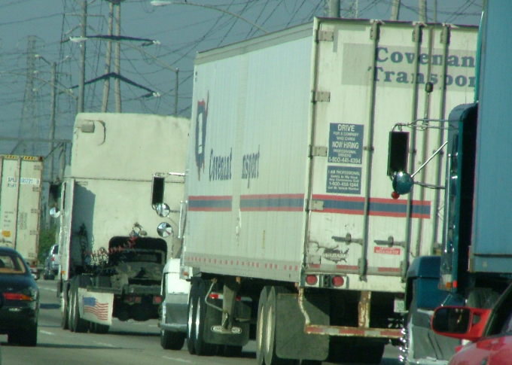
Freight Congestion A Key Element of the 21st Century Economy
U.S. urban truck delay
353M truck hours
$27B cost
$7.5T Value
In addition…
Inventory costs
Just-in-time operations
Fleet productivity
Distribution centers
The collaboration allows for computing these statistics using detailed speed data.

Slide 15
Where is the Truck Delay?
Delay Cost Value
New York 33M hrs $2.5B $481B
Los Angeles 30M hrs $2.3B $412B
Chicago 23M hrs $1.7B $362B
Atlanta 10M hrs $0.8B $192B
Dallas-Ft Wth 10M hrs $0.7B $230B
Boston 7M hrs $0.6B $129B
Average national truck congestion:
710,000 hours
$54M cost
$15B commodity value
The collaboration allows for computing these statistics using detailed speed data.

Slide 16
Recommendations for Successful Collaboration
Look for the “win-win”
Understand what each party wants/needs
Look for opportunities to continue collaboration
Future analyses, media opportunities
Industry trends – stay “cutting edge”
Communication – essential throughout

Slide 17
Websites
TTI: http://mobility.tamu.edu
2012 Urban Mobility Report
2011 Congested Corridors Report
Freight Mobility
Info on truck value, costs, measures, etc.
INRIX: inrix.com
Apps
Monthly Scorecard
Products and services

